Slide 1
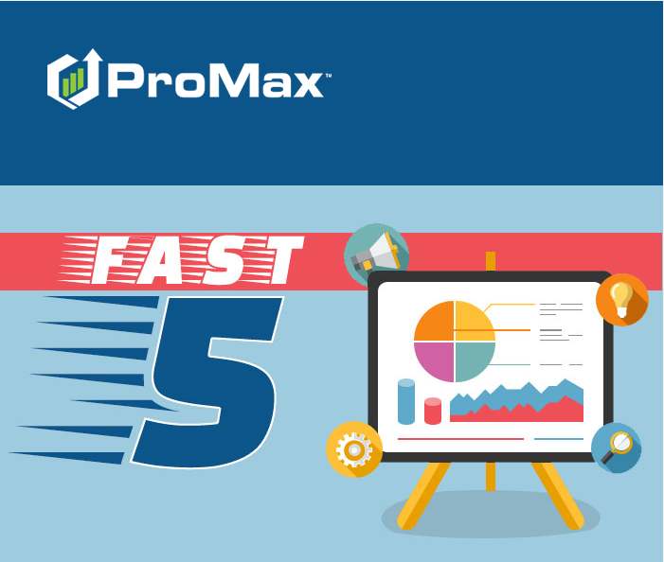
January

Slide 2
Agenda
Sub Prime Search
Cash Search
ProMax University
Retail Search
Lease Search

Slide 3
Lease Search
ProMax can help you find the most profitable lease deals at a glance

Slide 4
Lease Search
If you already know what vehicle the customer would like you can go to:
Customer > Retail/Lease
When you search this way it will show you the different lending options and the gross profit associated with those different deals at a glance.
From this screen you can also do a Retail vs Lease Comparison by hitting the Multi Option button.
Select the term the customer wants and then choose your payment to go to the deal screen.

Slide 5
Retail Search
ProMax makes it easy to find the most profitable retail deals.

Slide 6
Retail Search
Prospects > Retail/Lease Search
Stock number = ALL
Fill out all of your requirements for the deal.
Update lenders if desired.
Hit calculate deals.

Slide 7
Retail Search
Once you have all of your possible deals you can sort by profit or days in stock.
You can also hide profit in order to show the customer the screen or print off a sheet for the salesrep on what vehicles to show the customer.
When you decide on the vehicle, you can click on the payment hyperlink in order to access the deal screen.

Slide 8
Sub Prime Search

Slide 9
Sub Prime Search
The Sub Prime Search is very similar to the retail search, but it has less attributes to search on and uses your sub prime lenders in order to find deals.
Customer > Sub Prime Search
Fill out your criteria, adjust the lenders if you’d like, and hit calculate deals.

Slide 10
Sub Prime Search
Once your deal options come up you can sort them based off of profit or days in stock.
You can also hide the profit in order to show the screen to the customer or print a list for your sales rep to show the customer.
Click into the deal you want in order to access the deal screen.

Slide 11
Cash Search
Use this when a customer says, “I have $X to spend on a vehicle and not a penny more.”

Slide 12
Cash Search
The Cash Search is a little hidden. You have to first enter another search screen in order to see the cash search.
Customer > SubPrime Search.
Now choose the Deal Type drop down and select “Cash.”
Enter your criteria and hit calculate deals.
Once you have your list of deals, click into the “Total Due” Hyperlink in order to access the deal.

Slide 13
ProMax University
We have recently added another training tool for refreshers and new staff training on ProMax – ProMax University!

Slide 14
ProMax University
With ProMax University, you now get more insight into how your staff is retaining the information they are being given during ProMax trainings. You also now have insight on when they are attending their classes and you can assign specific courses for them as you see fit as well.
This training is interactive. There are quizzes after each section, screens you interact with to make sure you understand the steps to complete a task, and a new certification process.
In addition to ProMax training, you will also have access to other BDC and Sales training classes through this platform.

Slide 15
ProMax University
Home Screen

Slide 16
ProMax University
Classes

Slide 17
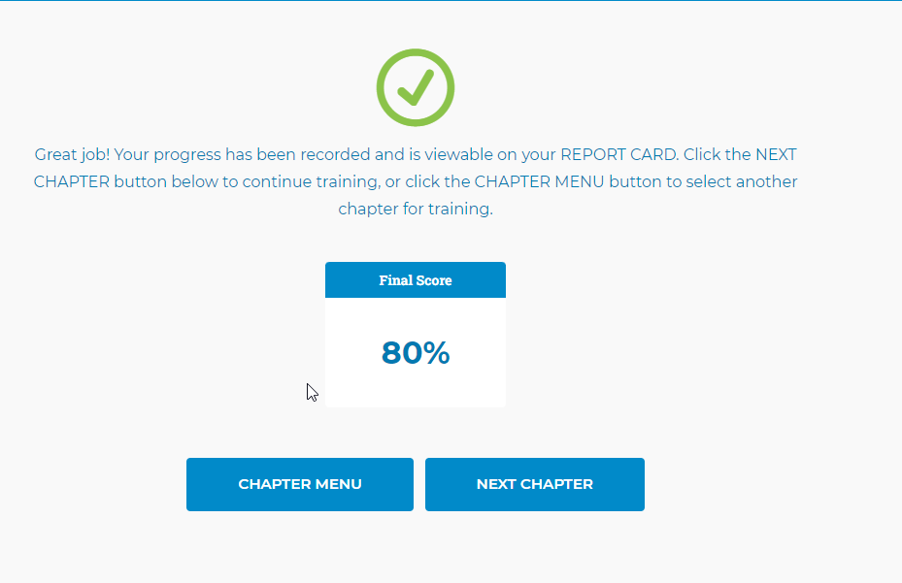
ProMax University
Quizzes

Slide 18
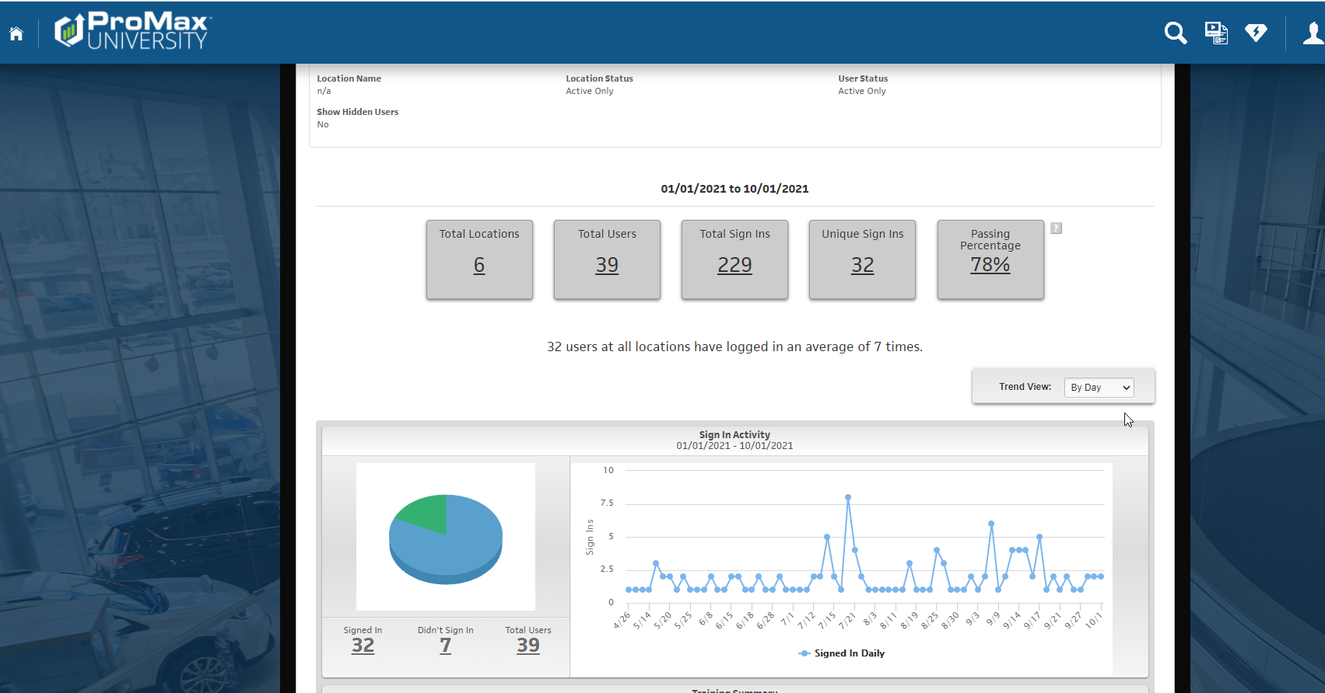
ProMax University
Reports

Slide 19
Questions?
Contact our Dealer Support Line at 844-322-9034
Contact me directly at 563-344-7618 or Trista@ProMaxUnlimited.com
PromaxUnlimited.com
Facebook.com/ProMaxUnlimited
Twitter.com/ProMaxUnlimited
LinkedIn.com/Company/ProMax-Automotive-Software/
DealerUpdates.TypePad.com/Blog/

